Slide 1
Algorithms & DS
Algorithm Complexity

Slide 2
Complexity
Frequently, there may be a number of algorithms to solve the same problem.
The question arises is: Is one algorithm better than another?
To answer this non-trivial question, leads us to the Analysis of Algorithms and how they can be compared.
One way to compare algorithms is to compare their performance in terms of how quickly they solve the problem.
Some algorithms are faster than others, we often choose the fastest one.

Slide 3
Complexity
How you use a telephone book to look up a number. What other way could you do it ?
Which way is faster ? Which way is simpler ?
Another way of comparing algorithms is to look at the amount of space (memory) they require.
Some algorithms require large amounts of space but find a solution quickly. Others require small amounts of space but find a solution less quickly.
So often there is a space/time trade-off.

Slide 4
Complexity
This means that improvement in one aspect leads to a disimprovement in another.
Example.
  A fast algorithm may require a lot of space.
  A slow algorithm may require a small amount of space.
Each trade-off situation must be evaluated separately. You cannot tell in advance which solution is appropriate until you know the details of the situation.
So in advance you cannot specify the ’best’ solution.

Slide 5
Complexity
If we have a number of algorithms, we can specify their relative performance and use this when choosing one for a particular problem.
We only consider one measure of performance here, the relative amount of time an algorithm takes to solve a problem.
This is called the time complexity of an algorithm.
But we are not interested in absolute times, i.e. how many seconds it takes to solve a given problem.

Slide 6
Complexity
The actual absolute time taken to solve a problem depends on a number of factors:
  how fast the computer is.
  RAM capacity of the computer.
  OS the computer uses.
  The quality of code generated by the compiler.
If any of these change, the actual time changes. So the absolute time is not very useful as a measure of an algorithm’s performance.
Each algorithm is a finite sequence of instructions. The more instructions there are, the longer it takes to execute.

Slide 7
Complexity
So we compare algorithms by counting the instructions that algorithm requires to solve the problem.
The number of instructions depends on the size of the problem input, usually n.
So we compute the number of instructions as a function of the size of the input.
For many algorithms, they consist of a main loop (or loops) which is executed for each element of the input.
So as input size increases, the number of instructions executed in the loop, is much greater than those before and after the loop.
So to simplify the calculations, we don’t count individual instructions outside the loop(s).

Slide 8
Complexity
Do we need to count all instructions inside the loop?
When we study algorithms, we find that the number of instructions inside the loop for any two algorithms to solve a specific problem does not vary much !
But what may differ is the number of times the loop is executed.
So we need to count the number of times loop is executed.
In our search algorithm, the loop compares A[i] with the key to be found. So it is the number of comparisons that we count to compare 2 search algorithms.
This clearly depends on the size of the list (n).

Slide 9
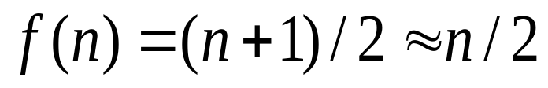
Complexity
We saw for linear search, the complexity was
This is a linear function. The amount of operations increases in linear proportion to the size n of the problem.
If key is not found, we find the number of comparisons is n.
We use the notation O(n) to describe this time complexity. It means “of order n”.
It is called the Big-O notation.

Slide 10
Complexity
Complexity is important for studying
  the efficiency of algorithms, and
  to compare different algorithms for same problem
Computing the complexity involves counting the operations for the algorithm (main loops), in terms of the problem (loop) size n.
Computational complexity is usually represented using the big-O notation.

Slide 11
Complexity big-O
A polynomial f(n) is a function that contains integer powers of n, i.e. n^{k.}
A polynomial of degree k has form
  p_{k}(n) = a_{k}n^{k} + a_{k-1}n^{k-1} +…+ a₁n+a₀
As n increases the term that grows fastest is a_{k}n^{k}. And we can ignore smaller terms.
We say that p_{k}(n) is O(n^{k}) i.e. is of order n^{k}

Slide 12
Complexity big-O
Any polynomial p_{k}(n) is of order its highest power.
Examples:
p₂(n) = 2n² + 4n +4 = O(n²)
p₁(n) = 3n + 4 = O(n)
p₃(n) = 2n³ + 3n² + 5n + 4 = O(n³)
This allows us to simplify the expression for the complexity, we’re interested in the behaviour of the function as n → large.

Slide 13
Complexity Rules big-O
O(n²) means is <= a*n² , a = constant
For n > 1 we have:
  n < n² < n³ < … < n^{k} < n^{k+1} < …
If f(n)= O(n^{k}) and g(n) = O(n^{m}) are functions.
Product
f(n)*g(n) = O(n^{k})* O(n^{m}) = O(n^{k+m})
Division.
  f(n)/g(n) = O(n^{k}) / O(n^{m}) = O(n^{k-m})
Log function is not a polynomial.
K*log(n) = O(log(n)) for K = constant.

Slide 14
Complexity Rules big-O
Note that:
log(n^{k}) = k*log(n) = O(log(n)) so log of all powers have the same order.
So log(n²) and log(n³) are O(log(n))
We know f(n) = log(n) increases very slowly.

Slide 15
Complexity examples
Simplify following expressions using big-O
  (i) (n+1)(n²+1)
  (ii) n(2n+1)(3n²+1)
  (iii) (n³ + 4n² + n)/(2n+1)
  Answers.
  (i) O(n)*O(n²) = O(n³)
  (ii) O(n)*O(n)*O(n²) = O(n⁴)
  (iii) O(n³)/O(n) = O(n²)

Slide 16
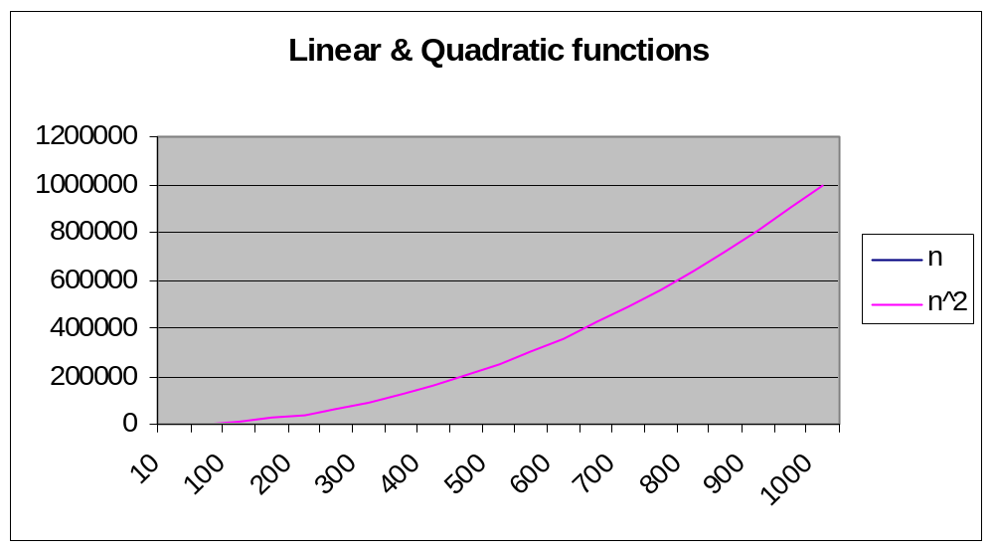
Complexity
Cannot see linear function as it’s so small.

Slide 17
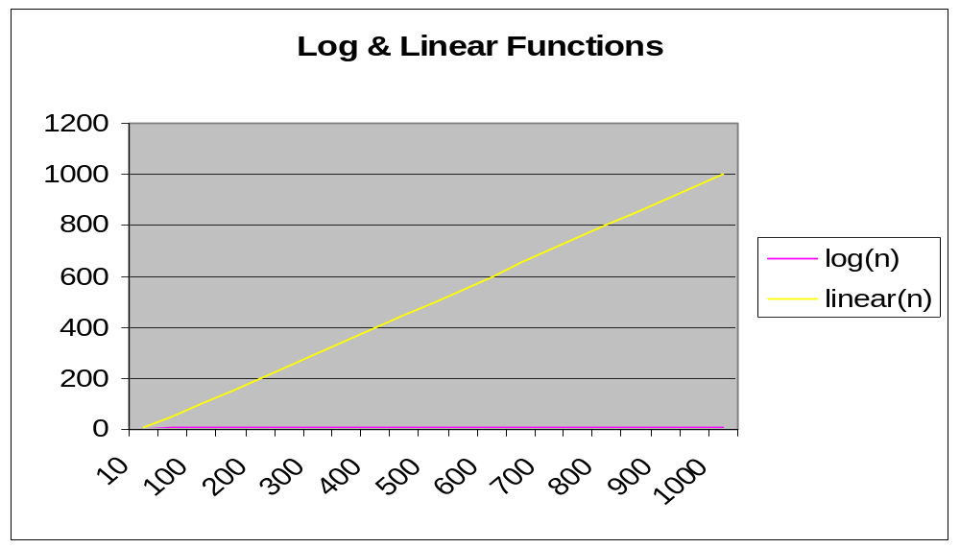
Complexity

Slide 18
Algorithm Analysis
Common functions f(n).
Linear: f(n) = a*n, a = constant
Quadratic: f(n) = a*n²
Cubic: f(n) = a*n³
Log function: f(n) = log₂(n)
n log(n): f(n) = a*n*log(n)
All these functions behave differently, as problem size n changes.

Slide 19
Some simple complexity functions
n | log n | n | n logn | n^2 | n^3 | 2^n
10 | 3 | 10 | 33 | 100 | 1000 | 1.E+03
20 | 4 | 20 | 86 | 400 | 8000 | 1.E+06
30 | 5 | 30 | 147 | 900 | 27000 | 1.E+09
40 | 5 | 40 | 213 | 1600 | 64000 | 1.E+12
50 | 6 | 50 | 282 | 2500 | 125000 | 1.E+15
60 | 6 | 60 | 354 | 3600 | 216000 | 1.E+18
70 | 6 | 70 | 429 | 4900 | 343000 | 1.E+21
80 | 6 | 80 | 506 | 6400 | 512000 | 1.E+24
90 | 6 | 90 | 584 | 8100 | 729000 | 1.E+27
100 | 7 | 100 | 664 | 10000 | 1000000 | 1.E+30

Slide 20
Exercises
Compute the complexity of following pseudocode using big-O notation.
(i) for i = 1 , n
      for j = 1 , n
      a(i, j) := 2.0
      end for
    end for
  (ii) for i = 1 , n
  a(i) := 2.0;
  b := 2*a(i)
  end for
  Ans. (i) O(n²), (ii) O(n)

